Slide 1


Micro Credit Defaulter Case Study
Submitted by
Alfinson John

Slide 2
Problem Statement
Microfinance Institutions (MFIs) are businesses that provide financial services to low-income people. When addressing unbanked poor families living in rural places with few sources of income, MFS becomes quite effective. Group Loans, Agricultural Loans, Individual Business Loans, and other Microfinance Services (MFS) are some of the Microfinance Services (MFS) provided by MFI.
Many microfinance institutions (MFI), experts, and donors promote the use of mobile financial services (MFS), which they believe are more convenient, efficient, and cost-effective than the traditional high-touch strategy used to deliver microfinance services for a long time. Despite the fact that the MFI industry focuses primarily on low-income households and is particularly valuable in these areas, MFS implementation has been uneven, with both substantial successes and failures.

Slide 3
They recognise the value of communication and how it influences a person's life, thus they focus on giving low-income families and impoverished consumers with services and products that can assist them in their time of need.
They've teamed up with a microfinance institution to offer micro-credit on mobile balances that must be paid back in five days. If the Consumer deviates from the course of repaying the loaned amount within the time period of 5 days, he is considered a defaulter. The payback amount for a loan of 5 (in Indonesian Rupiah) should be 6 (in Indonesian Rupiah), whereas the payback amount for a loan of 10 (in Indonesian Rupiah) should be 12. (in Indonesian Rupiah).
Here, we need to create a model that can be used to predict if a client would pay back the lent amount within 5 days of loan insurance in terms of probability for each loan transaction. Label '1' shows that the loan has been paid, indicating that it is a non-defaulter, whereas Label '0' indicates that the loan has not been paid, indicating that it is a defaulter.

Slide 4
Reading & Understanding the Data
To begin with we will read and understand the dataset. While reading the dataset we see that the target is already available in the dataset, which makes it a problem of Supervised Machine Learning. Based on the type of target, we will decide what kind of algorithms to be used. Here the target is classified hence we will use Classification algorithm on the dataset. Before applying algorithms we will have to clean and pre-process the data. Then we will have to split the dataset into training model and testing model. Only then we can apply algorithms on it.
Machine Learning Tools are consists of:
Preparation and data collection
Building models
Application deployment and Training

Slide 5
Exploratory Data Analysis
The dataset has 209593 rows.
There are 36 features and 1 target in the dataset. These are as follows:
'Unnamed: 0', 'label', 'msisdn', 'aon', 'daily_decr30', 'daily_decr90’, 'rental30', 'rental90', 'last_rech_date_ma', 'last_rech_date_da' 'last_rech_amt_ma', 'cnt_ma_rech30', 'fr_ma_rech30’, 'sumamnt_ma_rech30', 'medianamnt_ma_rech30', 'medianmarechprebal30’, 'cnt_ma_rech90', 'fr_ma_rech90', 'sumamnt_ma_rech90', 'medianamnt_ma_rech90', 'medianmarechprebal90', 'cnt_da_rech30’, 'fr_da_rech30', 'cnt_da_rech90', 'fr_da_rech90', 'cnt_loans30’, 'amnt_loans30', 'maxamnt_loans30', 'medianamnt_loans30', 'cnt_loans90’, 'amnt_loans90', 'maxamnt_loans90', 'medianamnt_loans90', 'payback30’, 'payback90', 'pcircle', 'pdate’
Here, Label is our target column.

Slide 6
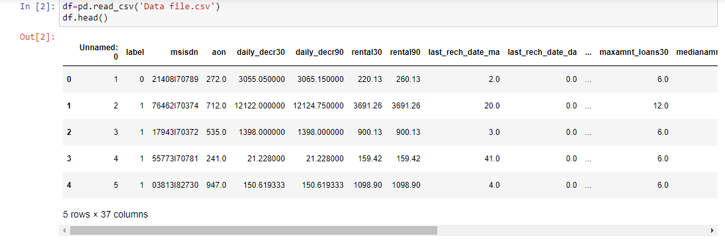
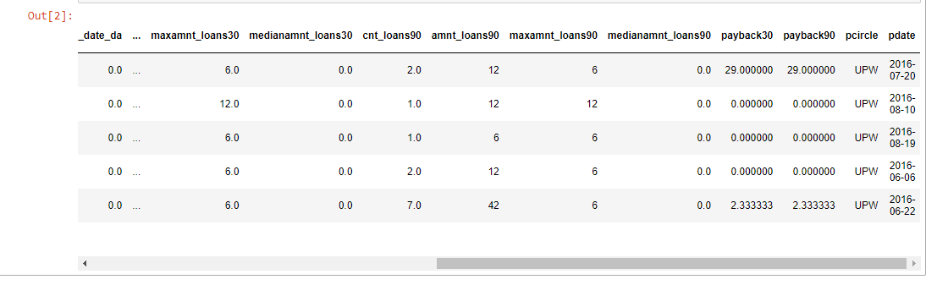
D
A
T
A
S
E
T

Slide 7
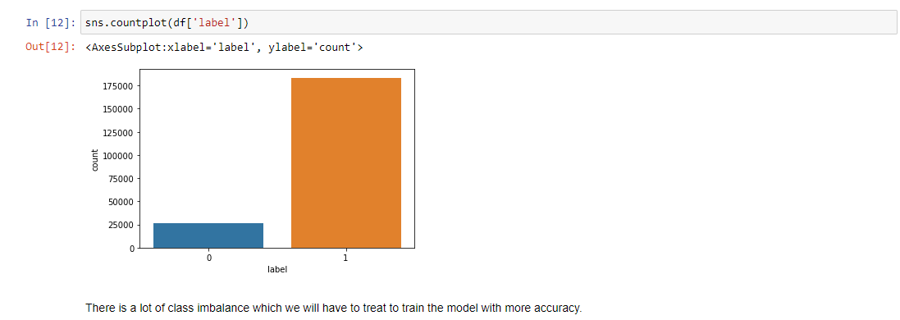
Univariate Analysis
We have drawn countplot, histogram, distribution plot, kde plot, pie charts, strip plot and box plot.
A countplot counts the categories and
returns the number of times they occur.
It's one of the seaborn library's more
straightforward plots.
Count Plot

Slide 8
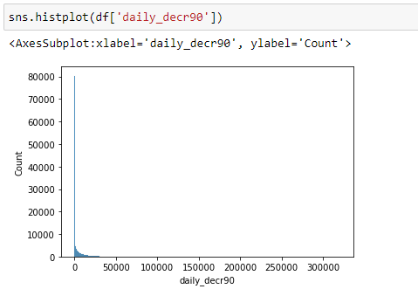
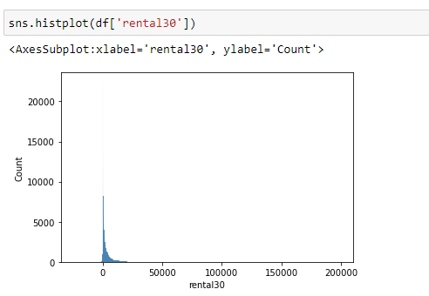
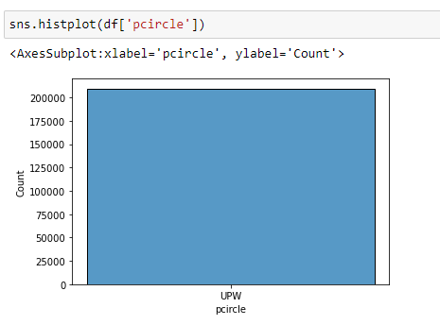
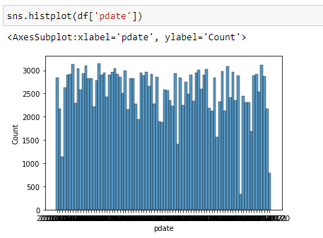
Histogram
Histogram: A histogram is a graphical representation of continuous data in a categorical format. Unlike a bar graph, there are no gaps between the bars in a histogram. The bins are all the same width.
Here we observe that the mobile number and date have very wide range of data which does not contribute much in prediction of ‘label’. And the feature ‘pcircle’ has only one type of value which also does not contribute in ‘label’ prediction. Hence we will drop all three.

Slide 9
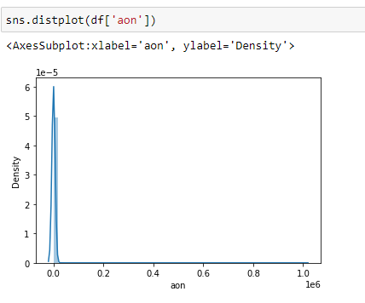
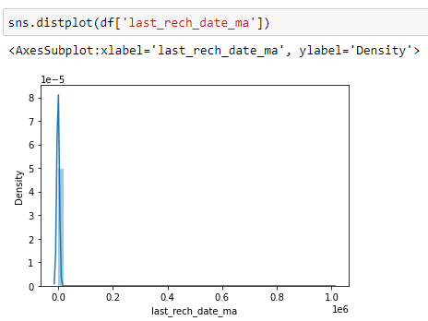
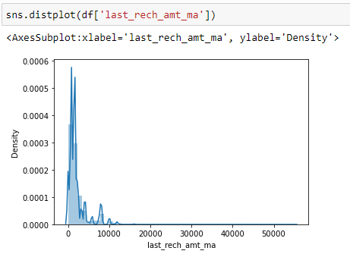
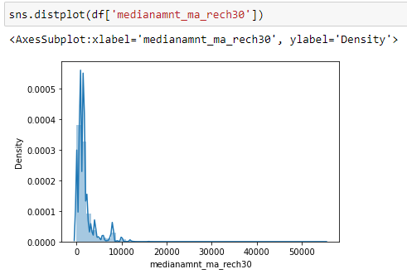
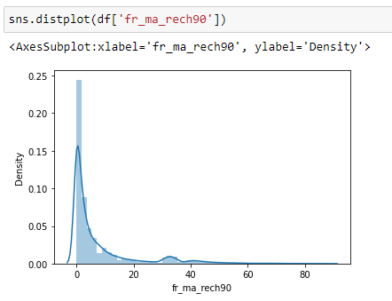
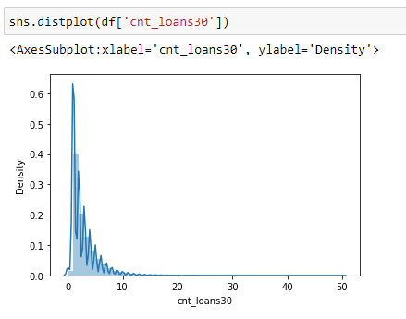
Distribution Plot

Slide 10
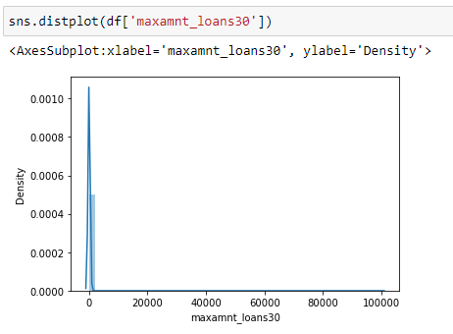
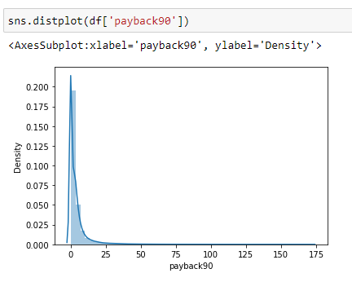
Distribution Plot: It is mostly used for univariant sets of observations and visualises them using a histogram, i.e. just one observation is used, and hence one column of the dataset is chosen. There is skewness in three columns which are ‘cnt_da_rech30’, ‘fr_da_rech90’ and ‘cnt_loans90’. To treat the skewness we will have to apply power transformation technique.

Slide 11
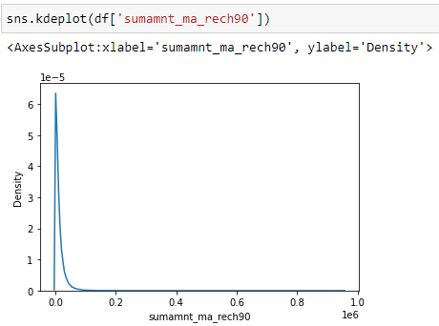
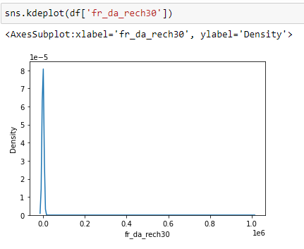
Kernel Density Estimate Plot
A Kernel Density Estimate plot is a way of showing distribution of observations in dataset. Here both the graphs are representing normal distribution.

Slide 12
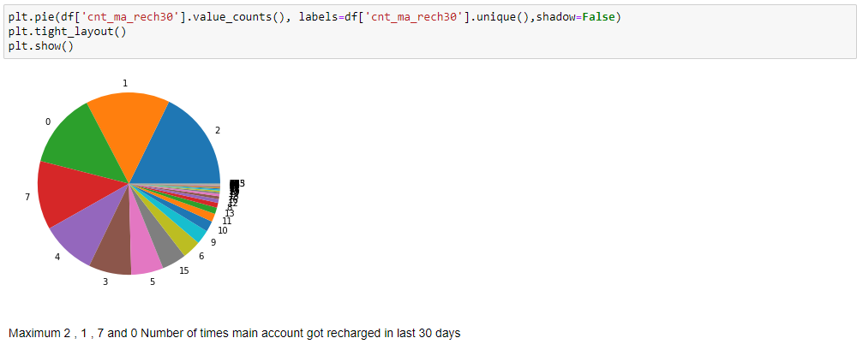
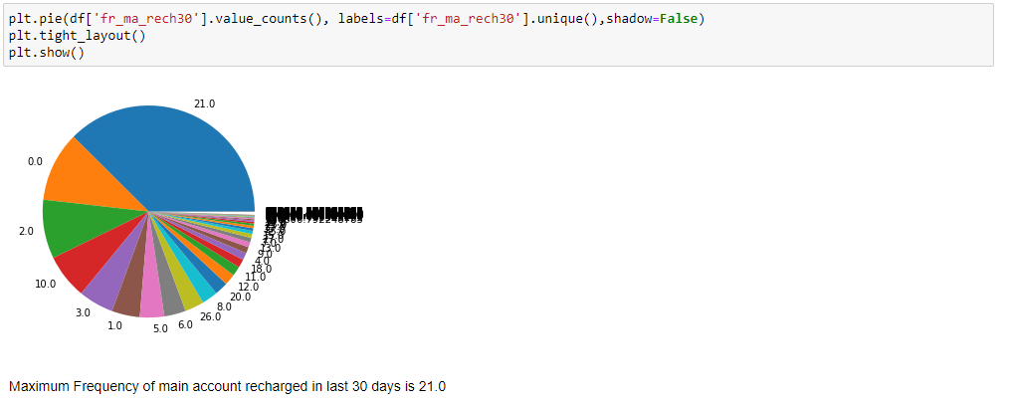
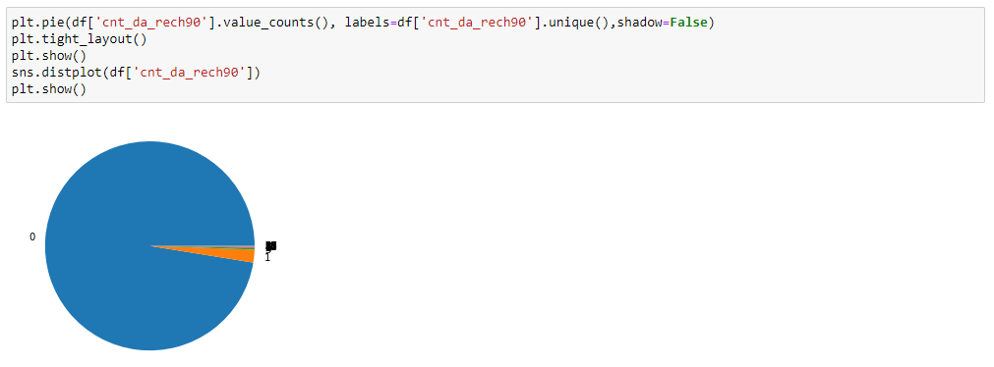
Pie Chart
A Pie Chart is a circular statistical layout that can only show one set of data at a time. The overall percentage of the provided data is represented by the chart's area. The proportion of sections of the data is represented by the area of the pie slices. Pie wedges are the pieces of the pie. The length of the wedge's arc determines the area of the wedge.

Slide 13
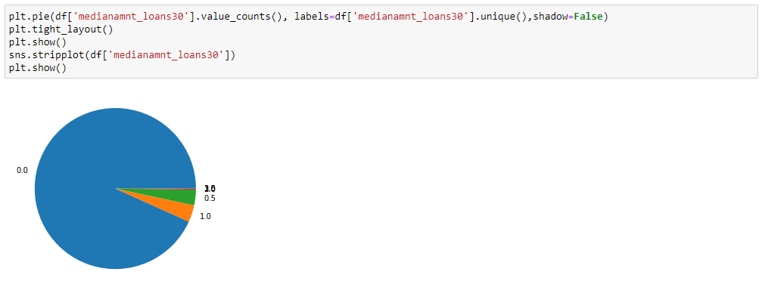
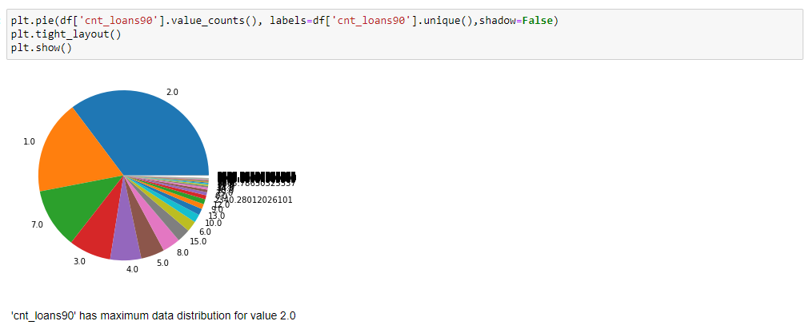

Slide 14
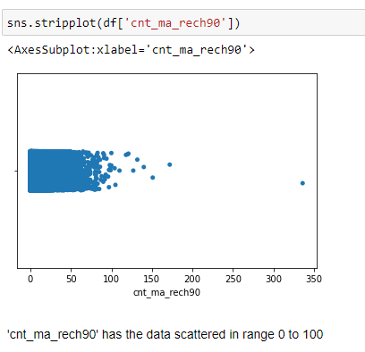
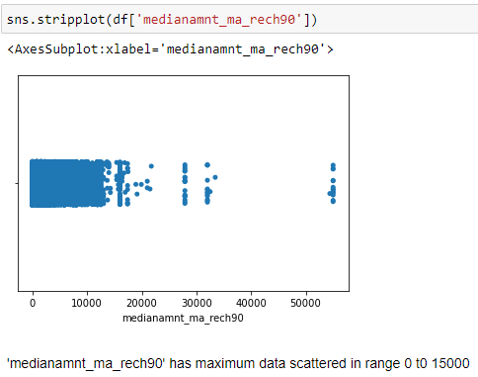
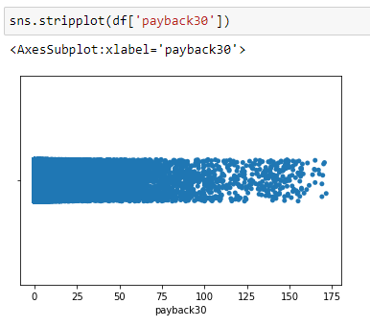
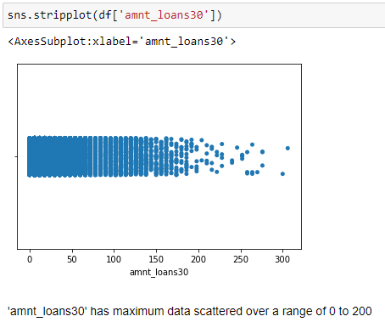
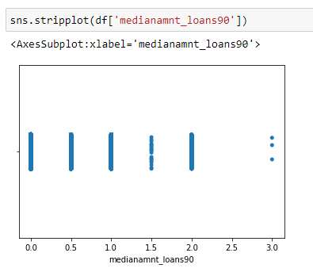
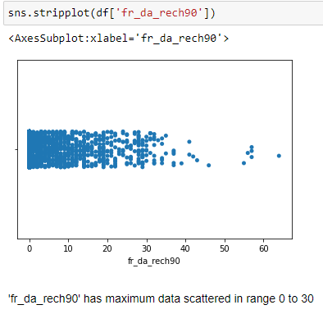
Strip Plot
It gives us the range over which the observations are distributed.

Slide 15
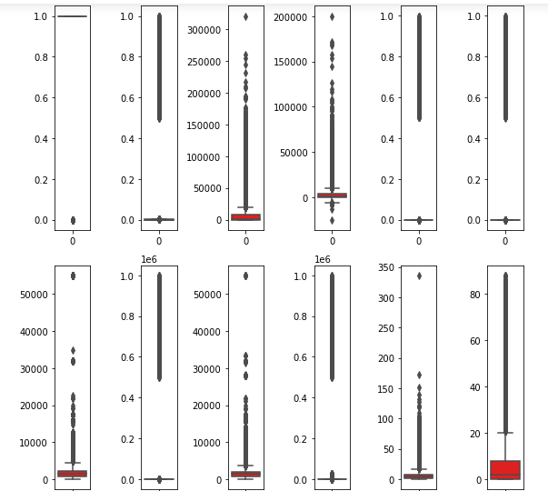
Box Plot
A single box plot can be used to illustrate multiple statistics from a vast quantity of data. It uses a number line to show the range and distribution of data. Box plots provide some insight into the symmetry and skewness of the data. Outliers are also visible in box plots.

Slide 16
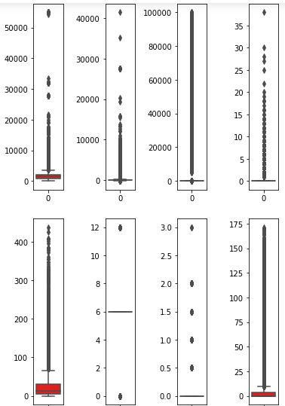
Box Plot
There are so many outliers in the dataset and if we remove all the outliers, we will lose almost 18% of the data and we can’t afford to lose that much of data, hence we will remove the outliers with zscore value more than 5 and in this way, we will lose only 7.5% of the data which is in acceptable range.

Slide 17
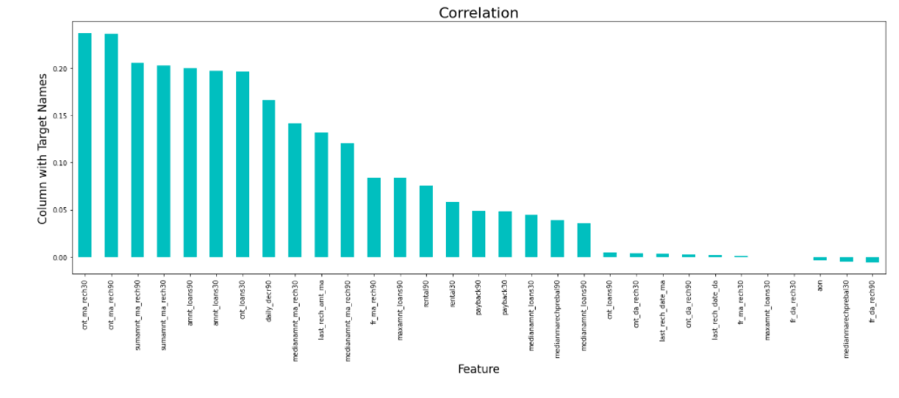
Bar Graph
While checking the correlation using Corr(), we found out that, two features have negligible correlation with the target, which we can happily drop to make our model more effective. These features are : ‘maxamnt_loans30’ (maximum amount of loan taken by the user in last 30 days) and ‘fr_da_rech30’ (Frequency of data account recharged in last 30 days).

Slide 18
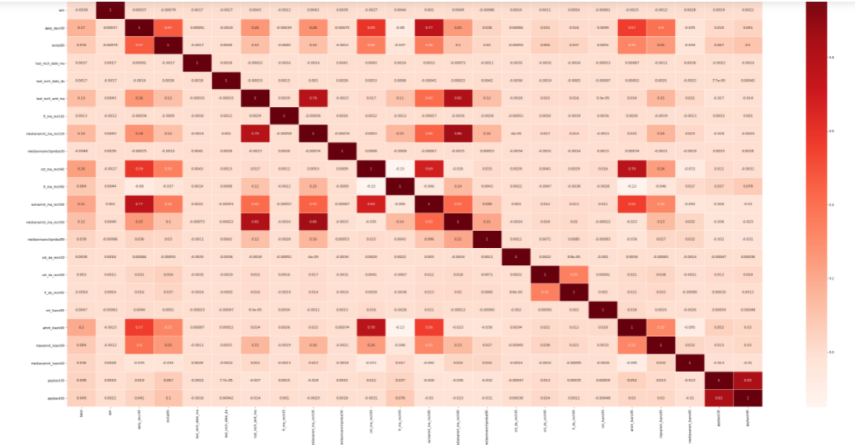
Heat Map
From the above heatmap we conclude that ‘cnt_ma_rech90’ has the maximum positive correlation with the target. As the value of ‘cnt_ma_rech90’ increases, there are more chances of a customer being a non-defaulter. ‘sumamnt_ma_rech90’, ‘amnt_loans90’ and ‘cnt_loans30’ have same positive correlation with the target and it’s second highest. Rest all the features have comparatively less correlation with the target. Moreover, ‘aon’ , ‘fr_da_rech90’ and ‘medianmarechprebal30’ are negatively correlated to the data at a very minimum number.

Slide 19
Data Cleaning
There are no missing values in the dataset.
There are many outliers in the dataset and to remove outliers, we will remove the observations having zscore value greater than 5.
There is skewness in few features and we will apply power transformation to treat that skew-ness.

Slide 20
Data Preprocessing
We will separate the features and target into x and y, respectively.
Now we will standardize the scale of features for better results.
Split the dataset into Training model and Testing model.
The answers lie in the data set. In order to test a machine learning algorithm, tester defines three different datasets viz. Training dataset, validation dataset and a test dataset (a subset of training dataset).
Balancing the class by Over Sampling.

Slide 21
Model Building
.
Since the dataset is quite large in size and it’s a classification problem, we will choose following algorithms to apply on our model:
Gaussian Naïve Bayes
Logistic Regression
Stochastic Gradient Descent Classifier
Decision Tree Classifier
Gradient Boosting Classifier
Random Forest Classifier

Slide 22
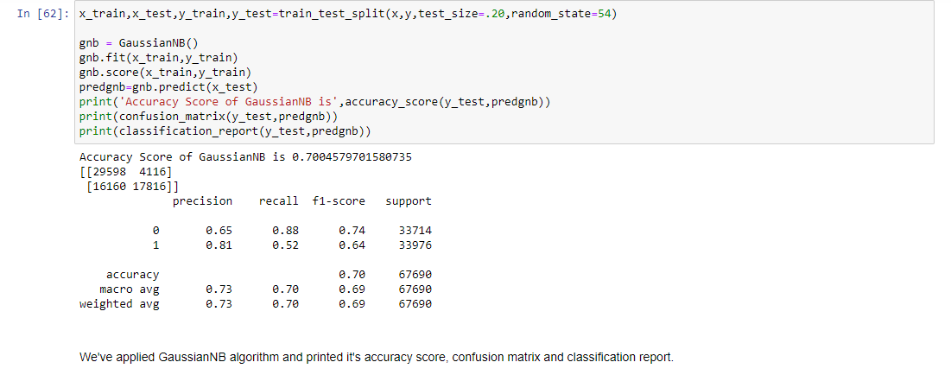
Gaussian Naïve Bayes
The accuracy of GaussianNB is 0.70 and the performance of the model based on precision and recall is also okay.

Slide 23
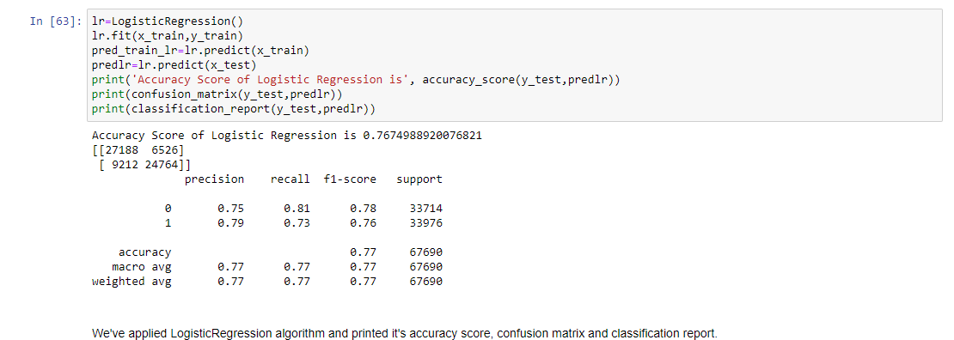
Logistic Regression
The accuracy of Logistic Regression is 0.76 and the performance of the model based on precision and recall is also okay.

Slide 24
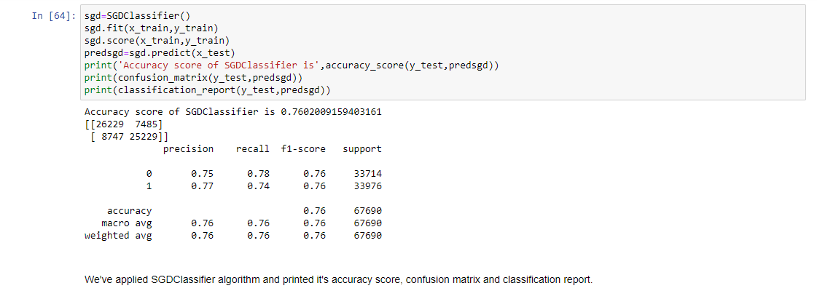
Stochastic Gradient Descent Classifier
The accuracy of Stochastic Gradient Descent is 0.76 and the performance of the model based on precision and recall is okay.

Slide 25
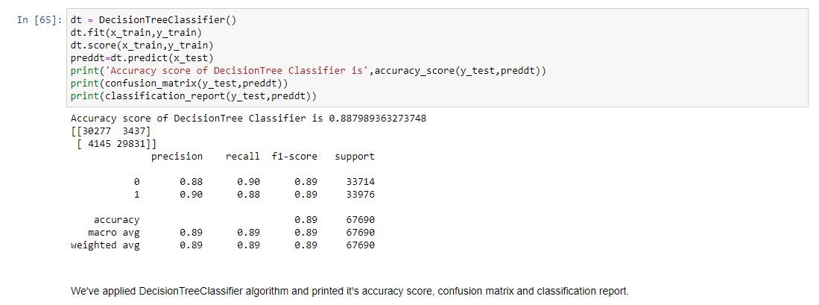
Decision Tree Classifier
The accuracy of Decision Tree Classifier is 0.88 and the performance of the model based on precision and recall is better than all the previous algorithms used.

Slide 26
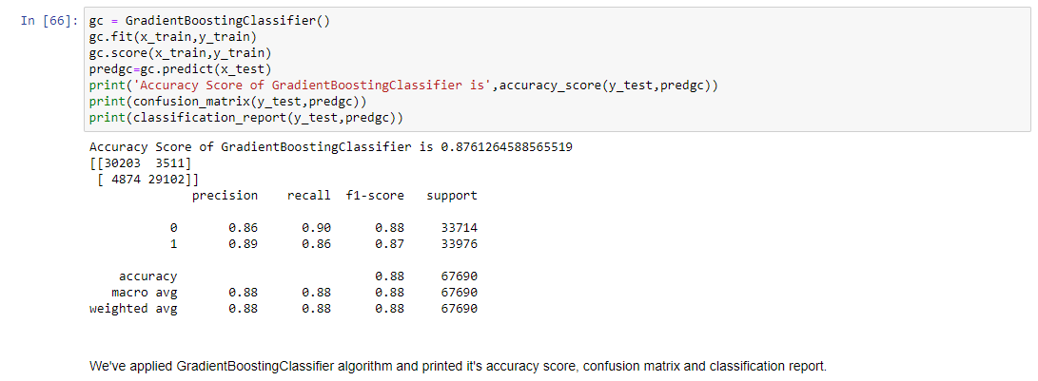
Gradient Boosting Classifier
The accuracy of Gradient Boosting Classifier is 0.87 which is quite appreciable. The confusion matrix for this algorithm is also in good shape. On the basis of F1 Score, Precision and Recall we can say that model performs quite well.

Slide 27
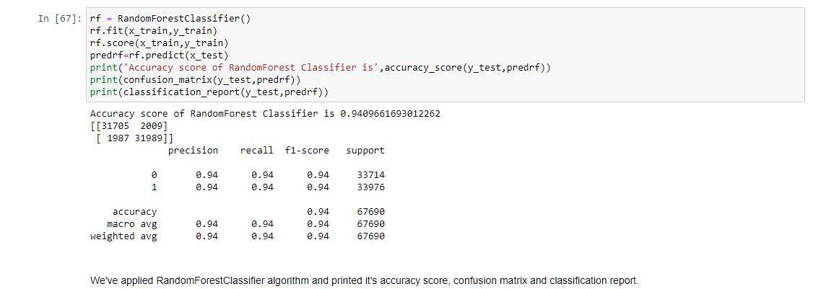
Random Forest Classifier
The accuracy of Random Forest Classifier is 0.94 which is quite appreciable. The confusion matrix for this algorithm is also in very good shape. On the basis of F1 Score, Precision and Recall we can say that model has acceptably high performance.

Slide 28
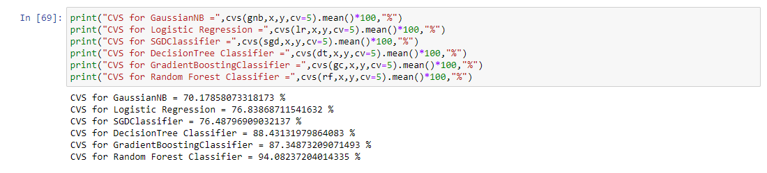
Cross Validation Score
Since the accuracy and model performance for Random Forest Classifier is highest; and the difference between accuracy and cross validation score for this algorithm is lowest, Hence we will choose Random Forest Classifier for Hyper Parameter Tuning.

Slide 29
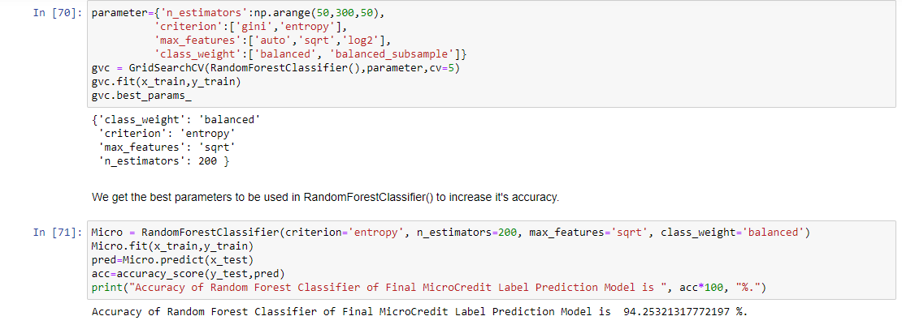
Hyper Parameter Tuning
First we pass few parameters in GridSearchCV to get the best fit parameter for our model.
Now we use these parameteric values in our finalized model. The accuracy , precision, recall and F1 Score has been increased after this operation.

Slide 30
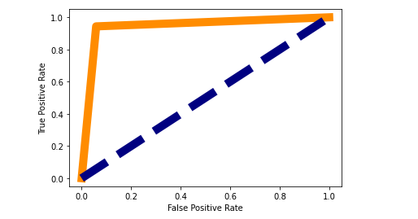
Area Under the Curve – Receiver Operating Characteristic Curve
AUC assesses how well predictions are ranked. Regardless of the classification threshold used, AUC also assesses the accuracy of the model's predictions.
A ROC curve is a graph that shows how well a classification model performs across all categorization levels.
By lowering the classification threshold, the model is able to classify more items as positive, resulting in a higher number of False Positives and True Positives.

Slide 31
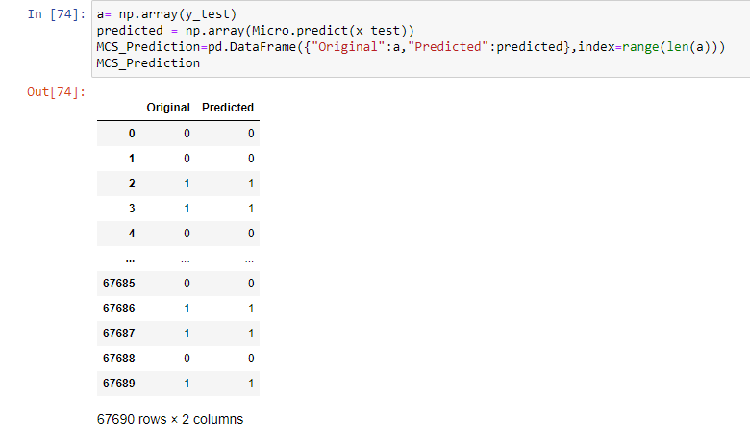
Conclusion
We conclude that our finalized hyper parameter tuned Random Forest Classifier Model is working really well. The values it has predicted are same as the original values.
Now we will save this model so that we can use this model for future prediction purpose.

Slide 32
Thank You

